Slide 1


ANN
Artificial Neural Network
Sadish P
Under the Guidance of
Dr. N. Vishwanathan M.Sc.,Ph.D.,
Notes:
<a href="https://www.freepik.com/free-vector/artificial-intelligence-machine-learning-concept-technology-background_4402949.htm?query=Artificial%20Intelligence">Image by starline</a> on Freepik
<a href="https://www.freepik.com/free-vector/abstract-neon-lines-background_4592105.htm">Image by pikisuperstar</a> on Freepik

Slide 2

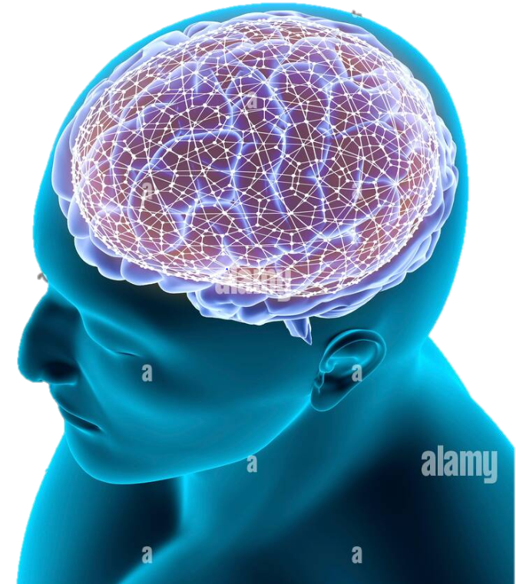



Abstract
Customers Churn Analysis
The development of the Bank Customer depends on its valuable Customers. So Customers Churn Analysis need to Customer’s Whether they are at risk of Leaving or Retaining .
Bank Strategy
From Organizational point of view, gaining new Customers is more difficult or more expensive than retaining existing Customers. Therefore the Customer Churn Analysis has been popular in bank Industry.
Model Building
In this Research Churn Prediction Model of classification Model of Classical Bank Customers is built by the Model is ANN ( ARTIFICIAL NEURAL NETWORK )
Notes:
<a href="https://www.freepik.com/free-vector/blue-abstract-technology-background_4666670.htm#query=background%20future&position=10&from_view=search&track=sph">Image by pikisuperstar</a> on Freepik
Photo by Yuyeung Lau on Unsplash

Slide 3

Introduction
The competitors are also ready to provide higher quality and lower prices for the same products and services. So, customers are shifting loyalties from bank to bank.
01
Our Study
02
Focus
This study is focused on the voluntary churn. To prevent this, the prediction of customer churn is necessary to determine whether customers can discontinue products or services
Traditional machine learning methods contain main drawbacks. they usually require so much time to extract features from thousands of customer attributes
03
Drawbacks
04
Deep Learning
They are faster than traditional methods. DL approaches can determine beneficial features without any prior knowledge
05
ANN
The experimental results showed that the ANN based prediction method produces better accuracy rates

Slide 4


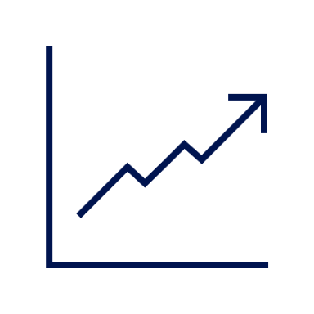

Objectives
01
02
03
04
Data Collection
EDA
Power BI
User Interface
The dataset for the study is called ‘Bank Customer” and is downloaded from Kaggle.com (Secondary data).
Exploratory Data Analysis is a data analytics process to understand the data in depth and learn the different data characteristics,
Power BI can help connect disparate data sets, transform and clean the data into a data model and create charts or graphs to provide visuals of the data
The UI Page, is used to the Client can know whether the customer are churned or not

Slide 5


Methodology
Artificial Neural Network
The term "Artificial Neural Network" is derived from Biological neural networks that develop the structure of a human brain. Similar to the human brain that has neurons interconnected to one another, artificial neural networks also have neurons that are interconnected to one another in various layers of the networks. These neurons are known as nodes.
Artificial neural networks (ANNs) or neural networks (NNs), are a subset of machine learning and are at the heart of deep learning algorithms
Their name and structure are inspired by the human brain, mimicking the way that biological neurons signal to one another.
ANN is an information processing model inspired by the biological neuron system. It is composed of a large number of highly interconnected processing elements known as the neuron to solve problems.

Slide 6




Working of Neural Network
A neural network works based on two principles
Forward Propagation
Backward Propagation
STEP 1
STEP 2
CLICK

Slide 7


Artificial Neural Network
05
Optimizer
04
Hence, it assists in improving the accuracy and reduces the total loss.
Optimizers help to get results faster
03
Loss Functions
Activation Function
Binary Cross Entropy is the negative average of the log of corrected predicted probabilities.
02
Neural networks use non-linear activation functions, which can help the network learn complex data, compute and learn almost any function representing a question, and provide accurate predictions
01
Weight Initialization
Neuron
Glorot Uniform
Weight should be small
Weight sould be Same
Weight should be good variance
A neuron performs
both functions
Summation

Slide 8
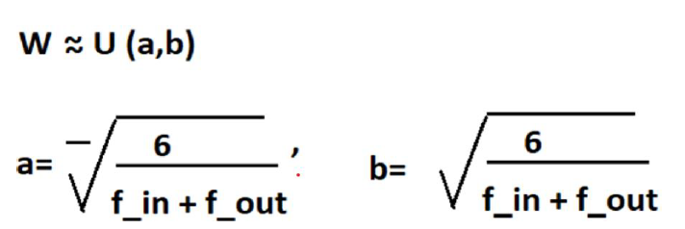
Glorot Uniform Initialization
Glorot Uniform initialization is the method which generate the initial value from Uniform distribution. Each layer has different max and min value of Uniform distribution depends on the number of input units and output units.
In case of statistical distribution, the library will generate numbers from that statistical distribution and use as starting weights
Glorot Initialization is used to maintain the same smooth distribution for both the forward pass as well the backpropagation.

Slide 9
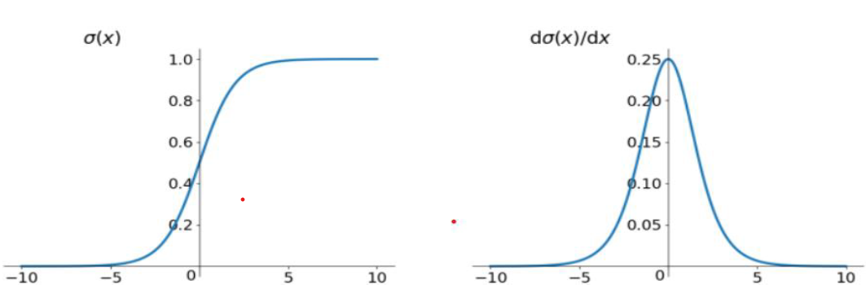
Activation Function
Sigmod Function
It is a smoothing function that is easy to derive
In the sigmoid function, we can see that its output is in the open interval (0,1)
When the backpropagation passes through the sigmod function, the differential on this chain is very small

Slide 10
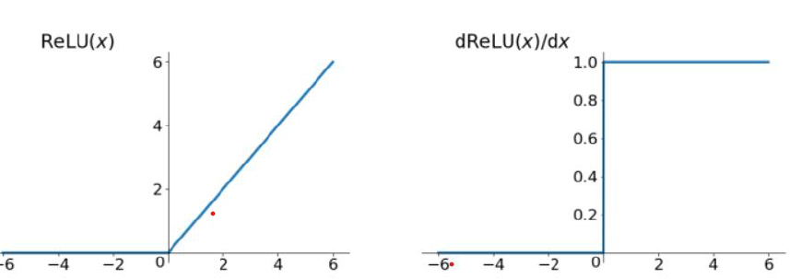
Activation Function
ReLU (Rectified Linear Unit) function
The ReLU function is actually a function that takes the maximum value.
The calculation speed is much faster. Whether it is forward or backward, it is much faster than sigmod and tanh.
The output of the ReLU function is either 0 or a positive number, which means that the ReLU function is not a 0-centric function.

Slide 11
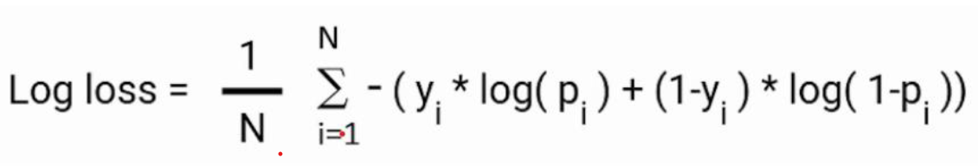
Loss Function
Binary cross entropy
Binary cross entropy compares each of the predicted probabilities to actual class output which can be either 0 or 1
It then calculates the score that penalizes the probabilities based on the distance from the expected value. That means how close or far from the actual value
The Binary cross-entropy using the formula

Slide 12
Optimizer Function
Adaptive Moment Estimation (Adam)
Adaptive Moment Estimation (Adam) is another method that computes adaptive learning rates for each parameter. In addition to storing an exponentially decaying average of past squared gradients like Adadelta and RMSprop.
Adam also keeps an exponentially decaying average of past gradients, similar to momentum.
Adam can be viewed as a combination of SGD with Momemtums ,Adagrad and RMSprop, (Adagrad) which works well on sparse gradients and (RMSProp) which works well in online and nonstationary settings repectively.
Adam implements the exponential moving average of the gradients to scale the learning rate instead of a simple average as in Adagrad. It keeps an exponentially decaying average of past gradients
Adam is computationally efficient and has very less memory requirement

Slide 13


Data Description
Data
ATTRIBUTE | DESCRIPTION | ATTRIBUTE | DESCRIPTION
Row Number | Number of customers | Surname | Customer name
Customer ID | ID of customer | NumOfProducts | No of products used by customer
Credit Score | Score of credit card usage | HasCrCard | If the customer has a credit card or not
Geography | Location of customer | IsActiveMember | Customer account is active or not
Gender | Customer gender | Estimated Salary | Estimated salary of the customer.
Age | Age of Customer | Exited | Indicates customer leaved or not
Tenure | The period of having the account in months | Balance | Balance Amount
The dataset for the study is called ‘Bank Customer” and is downloaded from Kaggle.com (Secondary data). Originally, the data was collected from an unknown bank with customers in France, Spain and Germany, and the aim of the study was to predict customer churn.
The data contains a total of 10000 observations with 14 variables, 1 dependent variable and 13 independent variables

Slide 14
Exploratory Data Analysis
Exploratory Data Analysis is a data analytics process to understand the data in depth and learn the different data characteristics, often with visual means. This allows you to get a better feel of your data and find useful patterns in it.
Below are the steps we will follow to reach our goal:
1. Importing necessary Libraries 5. Visualizing dataset
2. Loading and Reading dataset 6. Splitting the data
into train and test
3. Data Understanding
7. Building Models
4. Preprocessing
8. Save the Model

Slide 15
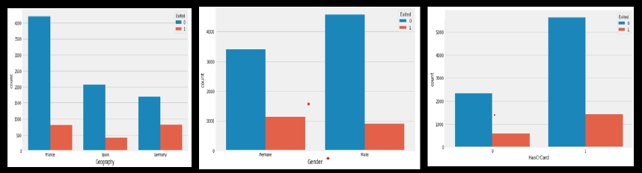
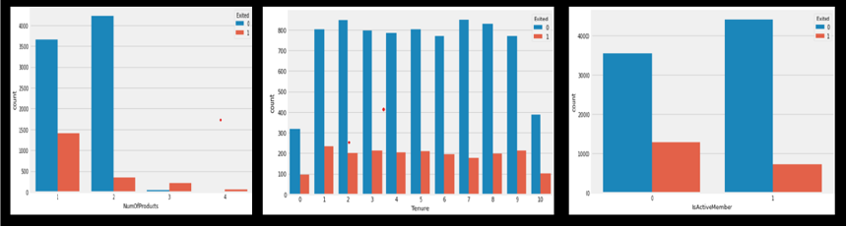
Visualizing dataset

Slide 16
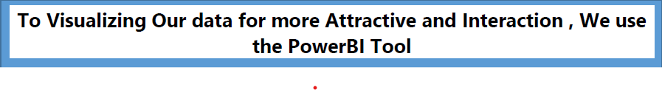
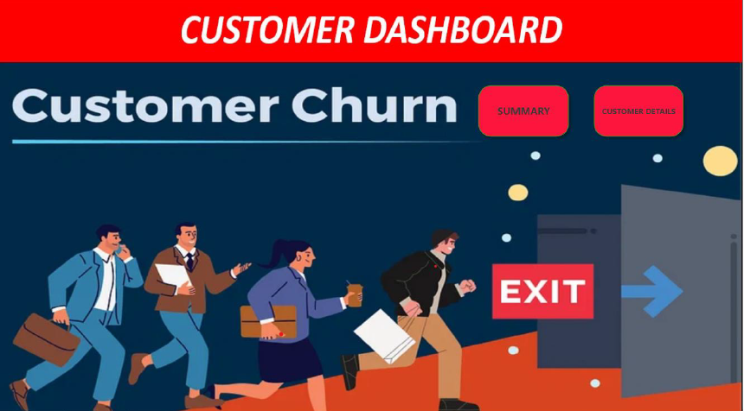
Power BI can help connect disparate data sets, transform and clean the data into a data model and create charts or graphs to provide visuals of the data. All of this can be shared with other Power BI users within the organization.

Slide 17
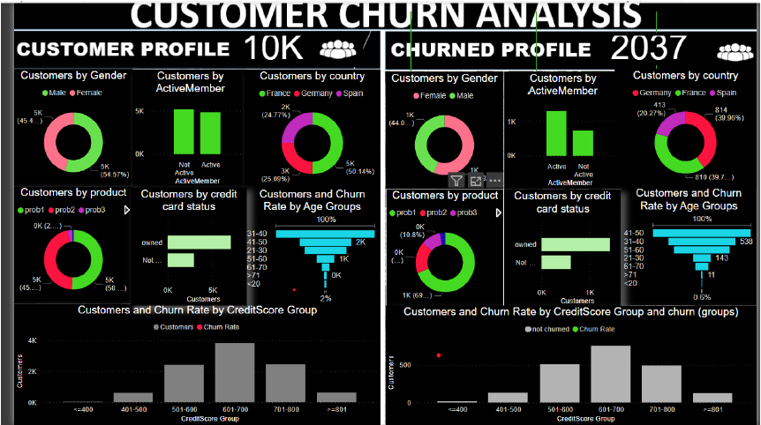

Slide 19
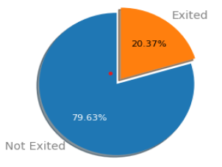
Observation
• There is 20%(2037) of customer are churned from the Bank. Remaining 80%
of customer are continue the service,
The Client more Concentrate to the Geography feature, as France and Germany Country People are Churned more than Spain .
The Client can give new Offer Or some discounts to the Customer.
• As compatibility Female are little more Churned than Males
• If, Credit card Holder are Churned, the Service is not Good, So the Client Should Change the Service,
or give Special Discount from a Credit Card Holder.
• If Number of Product is 1 , the Customer are not ready to buy the products, If the Customer are brought the
Product-1 those Customers are Churned.
• Tenure looking Normal, and if non-Active Customer are Churned

Slide 20
Data Interpretation
In Data Preprocessing ,there is No Missing and NAN Value
Detecting the Univariate and Multivariate Outlier
In Detecting the Univariate Outlier using the Z Score, We got the Outlier in Age Feature, So we remove the Indexes where Age is more than 80 and we lost only the 15 records . The final Data contain 9985 * 15 are used to predict the Model
In detecting the Multivariate Outlier using the Mahalanobis Distance , For Mahalanobis Distance we calculate the Mahalanobis Value and chi Square we calculate the P_Value, The p-value that is less than .001 is considered to be an outlier.
We get Outlier has 32 * 13
Here, The final Data contain 9968 * 13 are used to predict the Model
Accuracy = 85 | Sensitivity = 86 | Specificity =76
Accuracy = 85 | Sensitivity = 97 | Specificity =42

Slide 21
Data Interpretation
In Our study, We Check the collinearity between independent variables, VIF(Variance Inflation Factor), We make the cut off as 10, Credit Score feature shows 23.4,which is greater than cut off, We remove the Credit Score Feature
To improve the Accuracy, Sensitivity, Specificity. We use the Hyper Parameter Tunning, we shall increase the Hidden Layers, Nodes, change the Optimizer, loss function ,initialize the weight as he_uniform,he_normal the accuracy will Increase but Sensitivity, Specificity will descrease
To Increase the Accuracy, Sensitivity, Specificity to collect more data from the bank and interpret the result
In Our study the Univariate Outlier be the Good Accuracy, Sensitivity, Specificity. So Consider the Model used to deploy in the pipeline
This model is used to Predict Wheather Customer are Churned or Not.
This User Interface may help Bank Manager, how the customers are churned and what factor are affect can easily Identified and develop the marketing actions, to retain their valuable clients. Thus, due to existing customers are retained, it will provide banks with increased profits and revenues.

Slide 23
Customer will not Leave the Bank for these Specific Value

Slide 24
Conclusion
The model developed will help clients to identify, who are likely to be churned and develop appropriate marketing actions to retain their valuable clients. And this model also supports information about similar customer group to consider which marketing reactions are to be provided. Thus, due to existing customers are retained, it will provide banks with increased profits and revenues.
On the other hand, if the dataset is large and contains many independent variables, ANN - Artificial Neural Network is the most computationally effective method that also yields the best results, as discussed previously.
In this study, the Univariate Outlier and Multivariate Outlier yields different results. Among these two-outlier detection technique, the Univariate Outlier technique that provided better accuracy, sensitivity and specificity are considered
This concludes that the Customer in France and Germany is more churned than the customers in Spain. Based on Gender Feature, Female are more likely to churn than Male. Credit Card Holders are comparatively churned higher than the other Customers. Non-Activate Customers are Churned more than Others. Customers between the age group of 41 and 60 are churned more than others.
Here, we conclude that the Statistical Model, Artificial Neural Network gives the high level of accuracy which is 85% with sensitivity and specificity of 86% and 76% respectively using Mahalonobis distance measure.

Slide 25


SADISH P
Thank You
Notes:
<a href="https://www.freepik.com/free-vector/futuristic-artificial-intelligence-face-technology-background_4402943.htm#query=ai&position=45&from_view=search&track=sph">Image by starline</a> on Freepik

